Slide 1

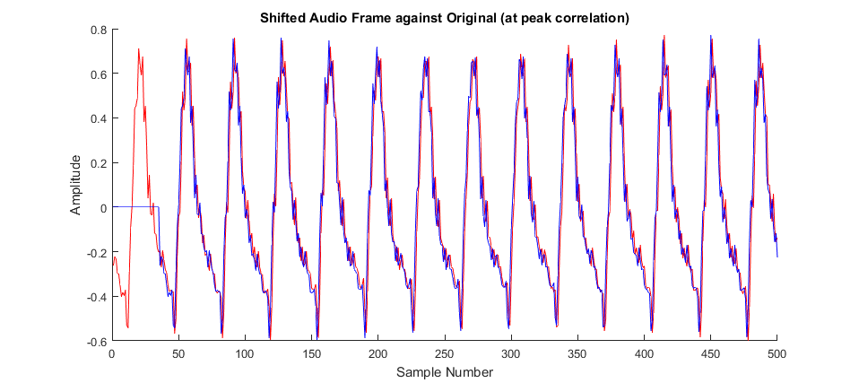
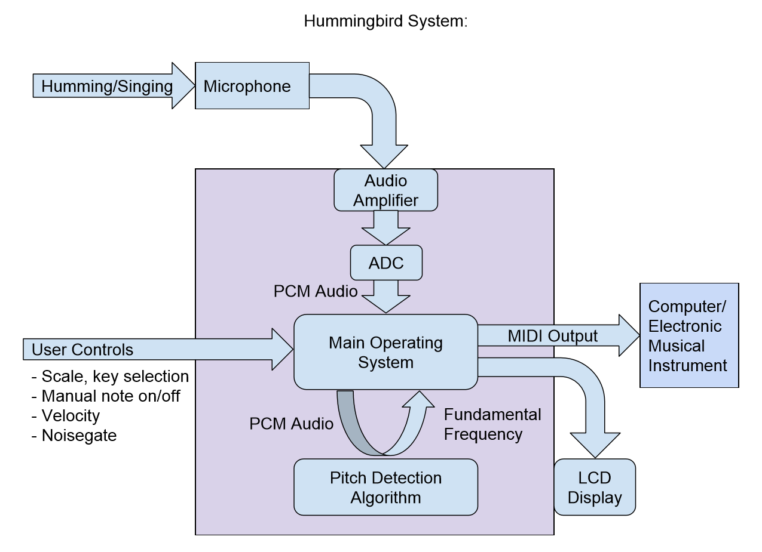
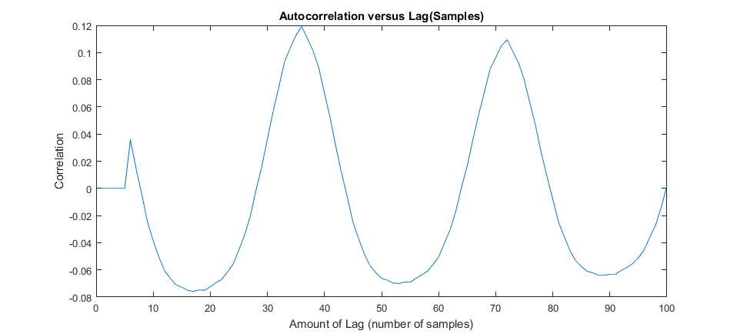
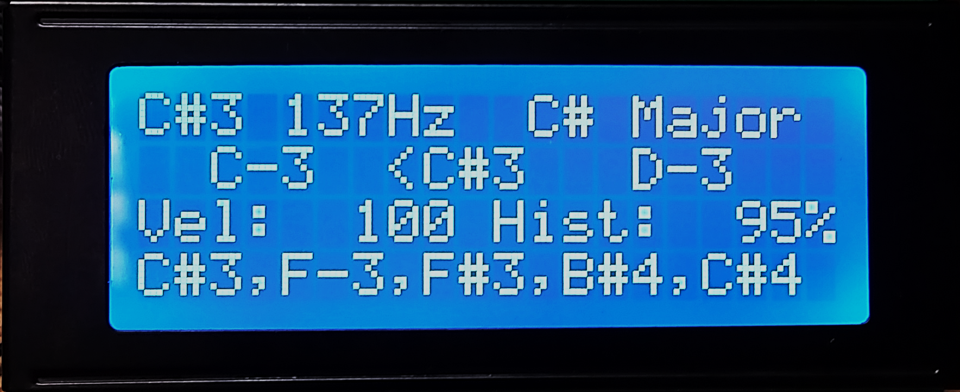
Hummingbird: Acoustic Control for Electronic Musical Instruments
Joey Devoto, Marcus Gronberg, Andre Marquez, Jason Vance
Abstract
Overview
Analysis
There are numerous tools that allow artists to create electronic music. However, the primary method of composition is either some type of digital piano or mouse-and-keyboard composition in a Digital Audio Workstation. Our goal is to deliver a system that makes the process of creating digital music more intuitive and easy.
The Hummingbird is a music tool that allows the user to play musical instruments and compose music by humming. The pitch hummed is used to generate MIDI data, which can be used to play instruments or record compositions using a Digital Audio Workstation. This process happens in real-time, giving the user the sensation and control associated with playing a traditional instrument, while retaining the low skill required to hum melodies as they come to mind.
Pitch Detection Algorithm (Autocorrelation):
The PDA functions by comparing the original audio frame to time lagged versions of itself.
By comparing the correlation of different amounts of lag, the period of the signal can be estimated.
Approach
Platform
Developed on a CY8CKIT-059 PSoC 5LP Prototyping Kit
Audio Acquisition:
The signal from the microphone is fed into an analog signal conditioning circuit
The system captures the signal using a successive approximation ADC
Pitch Detection Algorithm:
The input audio is sampled at a rate of 4000 samples/second into frames of 256 samples
Each frame is processed by the pitch detection algorithm to detect the fundamental frequency
This frequency is converted into a MIDI note, and is output over USB or MIDI port.
User Interface:
To improve the accuracy of the MIDI note, the user can select a specific key and scale. Each frequency interpreted by the pitch detection algorithm is snapped to one of the notes in this scale.
Conclusion
Note, Frequency, Key/Scale
Tuner
Our team’s ambition is to break down the barrier between creative thought and execution. The application of this system is not limited to music production, and might be applied towards musical education as well. We hope to move the project into commercial development in the near future.
MIDI Velocity, Hysteresis
Previous Notes
Acknowledgments
Project Mentor – Dr. Patrick E. Mantey
Peer Advisor – Eric Cao

